Slide 1
EE 445L – Embedded System Design Lab
Real-time Operating Systems
For more information see Volume 3 (EE445M)
EE 445L – Bard, Valvano
1

Slide 2
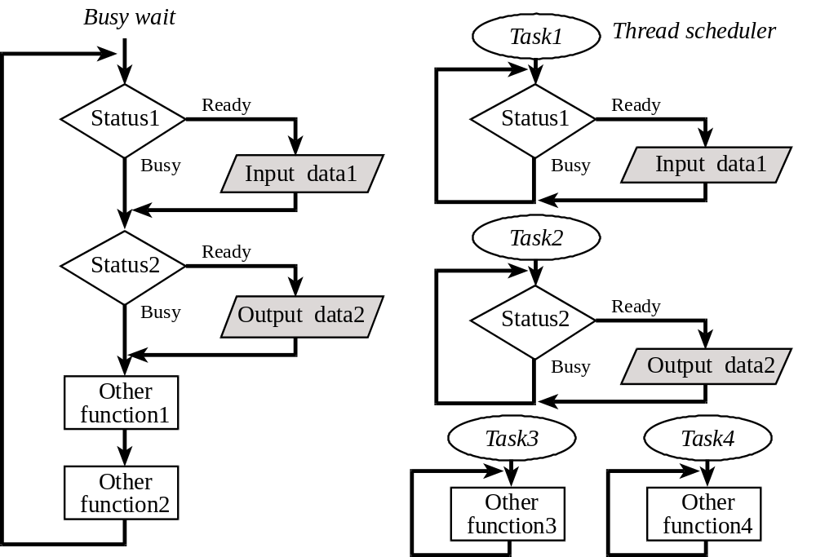
Single thread vs multithread

Slide 3
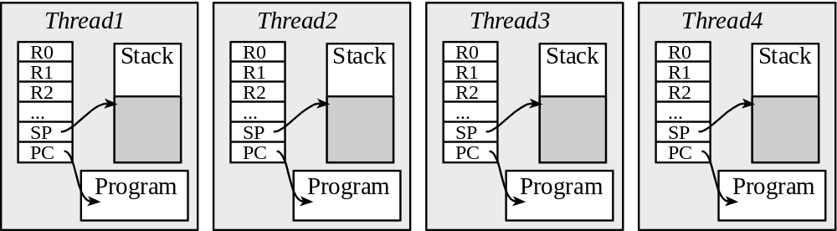
What is a thread?
Show SysTick handler
Jonathan Valvano EE445M/EE380L.6

Slide 4
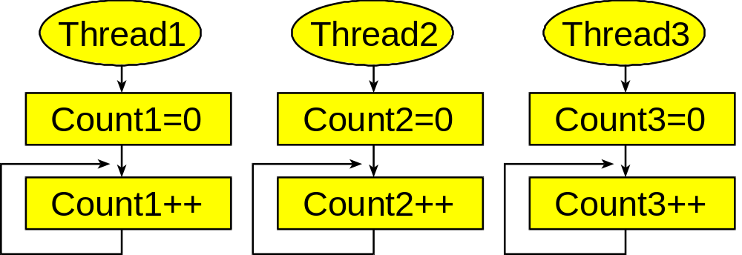
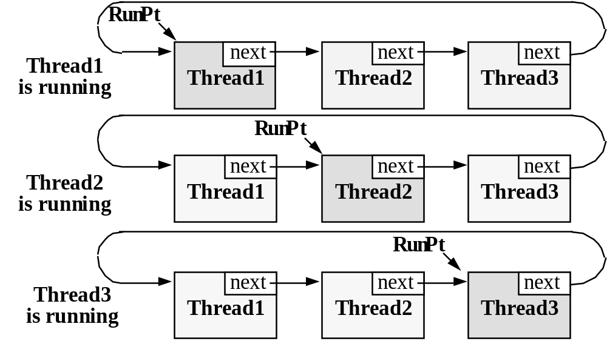
Threads
TCB
Stacks
Scheduler
See Testmain1
See Testmain2
Reference book, chapter 4
Jonathan Valvano EE445M/EE380L.6

Slide 5
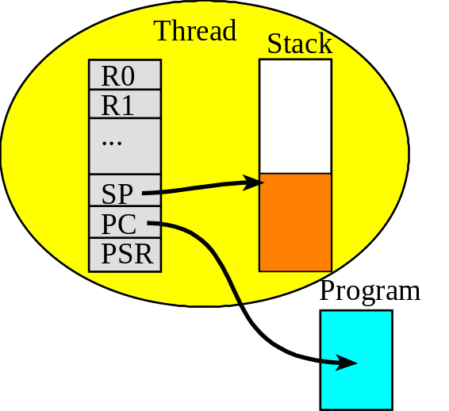
Thread or Light-weight process
Execution of a software task
Has its own registers
Has its own stack
Local variables are private
Threads cooperate for common goal
Private global variables
  Managed by the OS
  Allocated in the TCB (e.g., Id)
Jonathan Valvano EE445M/EE380L.6

Slide 6
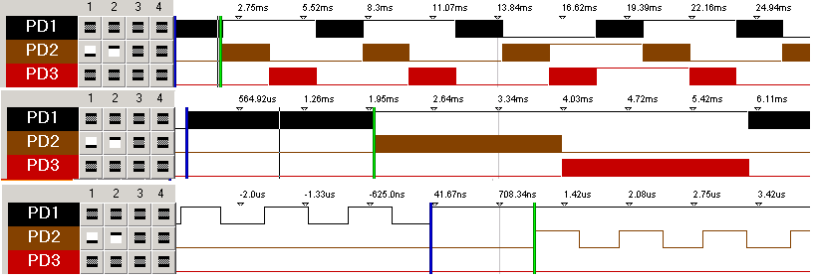
Demonstration
Show RTOS_4C123
Run in simulator
Show Port D profile
SysTick_Handler ; 1) Saves R0-R3,R12,LR,PC,PSR
CPSID I ; 2) Prevent interrupt during switch
PUSH {R4-R11} ; 3) Save remaining regs r4-11
LDR R0, =RunPt ; 4) R0=pointer to RunPt, old thread
LDR R1, [R0] ; R1 = RunPt
STR SP, [R1] ; 5) Save SP into TCB
LDR R1, [R1,#4] ; 6) R1 = RunPt->next
STR R1, [R0] ; RunPt = R1
LDR SP, [R1] ; 7) new thread SP; SP = RunPt->sp;
POP {R4-R11} ; 8) restore regs r4-11
CPSIE I ; 9) tasks run with interrupts enabled
BX LR ; 10) restore R0-R3,R12,LR,PC,PSR
Jonathan Valvano EE445M/EE380L.6

Slide 7
Thread or Task
void Producer(void){
unsigned short data;
data = ADC_In();
if(OS_Fifo_Put(data) == 0){
DataLost++;
}
}
Show main, threads in Lab7 (at end)
void Consumer(void){
unsigned short data,average;
unsigned long sum;
unsigned short n;
for(;;){
sum = 0;
for(n = 0; n < LENGTH; n++){
data = OS_Fifo_Get();
sum = sum + data;
}
average = sum/LENGTH;
OS_MailBox_Send(average);
}
}
void Display(void){
unsigned long data,voltage;
for(;;){
data = OS_MailBox_Recv();
voltage = 31*data/64;
LCD_Message(0,"v(mV) =",voltage);
}
}
Jonathan Valvano EE445M/EE380L.6

Slide 8
Real-time tasks
Hard real-time
  Bounded latency
Soft real-time
  Execute ASAP
Not real-time
Jonathan Valvano EE445M/EE380L.6

Slide 9
Thread Classification
Periodic, execution at regular intervals
  E.g., ADC, DAC, motor control
  E.g., Check CO levels
Aperiodic, execution can not be anticipated
  Execution is frequent
  E.g., New position detected as wheel turns
Sporadic, execution can not be anticipated
  Execution is infrequent
  E.g., Faults, errors, catastrophes
Jonathan Valvano EE445M/EE380L.6

Slide 10
Thread Scheduler
List possible thread states
List possible scheduling algorithms
  What?
  How?
  Why?
Performance measures
  Utilization
  Latency
  Bandwidth
When to run scheduler??
Round robin
Weighted round robin
Priority
Static
Dynamic
Deterministic
Jonathan Valvano EE445M/EE380L.6

Slide 11
Priority
Execute highest priority first
  Can you have two tasks at same priority?
Minimize latency on real-time tasks
Assign a dollar cost for delays
  Minimize cost
Jonathan Valvano EE445M/EE380L.6

Slide 12
Priority Schedulers
Earliest deadline first, dynamic
Earliest slack-time first , dynamic
  Slack = (time to deadline)-(work left to do)
Rate monotonic scheduling, static
  Assign priority based on how often Ti is runs
  Lower Ti (more frequent) are higher priority
Jonathan Valvano EE445M/EE380L.6

Slide 13
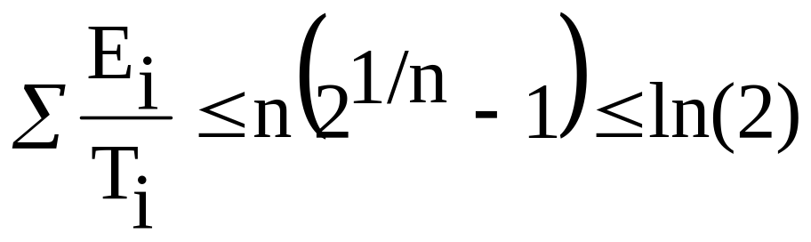
Rate Monotonic Scheduling Theorem
All n tasks are periodic
  Priority based on period of T_{i}
  Maximum execution time E_{i}
No synchronization between tasks
Execute highest priority task first
Jonathan Valvano EE445M/EE380L.6

Slide 14
Time Management
System time
Time stamps
  When did it occur?
  Performance measures
Thread sleeping
Measurements
  Input capture period -> wheel RPM
  Input capture PW -> ultrasonic distance
Jonathan Valvano EE445M/EE380L.6

Slide 15
Communication
Types
  Data sharing
  Pipes=FIFO (one to one, buffered, ordered)
  Mailbox (one to one, unbuffered)
  Messages (many to many)
Deadlock
  prevention, avoidance, detection, recovery
Performance measures
  Latency
  Bandwidth
  Error rate
Jonathan Valvano EE445M/EE380L.6

Slide 16
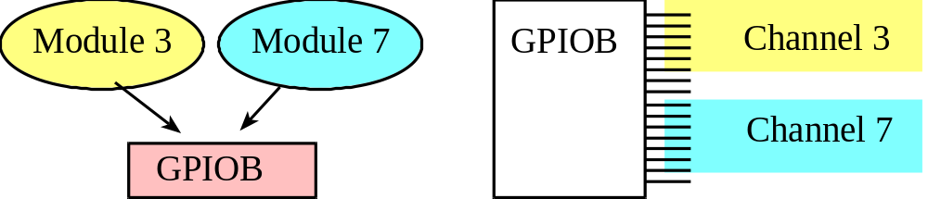
Race condition
Two or more threads access the same global
At least one access is a write
Jonathan Valvano EE445M/EE380L.6

Slide 17
Race, Critical Sections
Permanently allocated object
  Shared variables
  I/O ports
Write access changes official copy
Read access creates two copies
  Original copy in memory
  Temporary copy in register
Nonatomic access, load/store architecture
Jonathan Valvano EE445M/EE380L.6

Slide 18
Reentrant
Variables in registers, stack
No nonatomic write sequence
  Permanently allocated object
  WR, RMW, WW sequence
Look at programming manual
LDREX STREX
CortexM3Programmer.pdf pg33,71
CortexM3InstructionSet.pdf pg 39
Jonathan Valvano EE445M/EE380L.6

Slide 19
Making the access atomic
Disable all interrupts
Lock the scheduler
  No other foreground threads can run
  Background ISR will occur
Mutex semaphore
  Blocks other threads trying to access info
  All nonrelated operations not delayed
Measure time with I=1
- Maximum time
- Total time
Show code with NestCnt++
If NestCnt-- == 0 then run or
don’t run scheduler??
Jonathan Valvano EE445M/EE380L.6

Slide 20
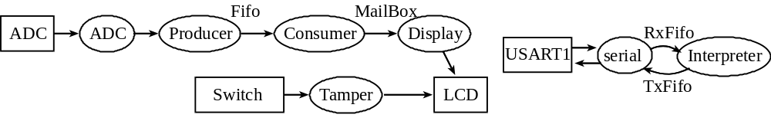
Synchronization
Sequential
Fork, spawn, join
Rendezvous
Trigger, event flags
Sleep
Jonathan Valvano EE445M/EE380L.6

Slide 21
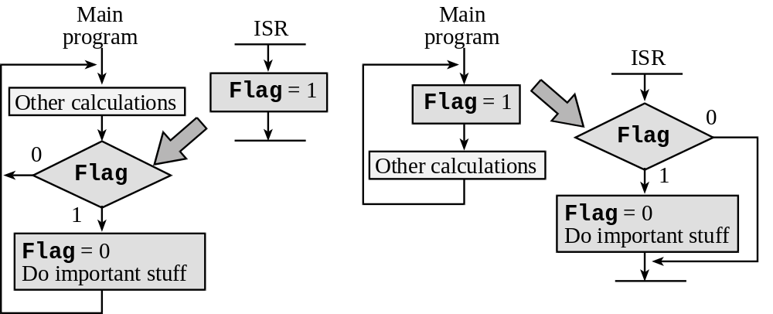
Semaphore
Jonathan Valvano EE445M/EE380L.6

Slide 22
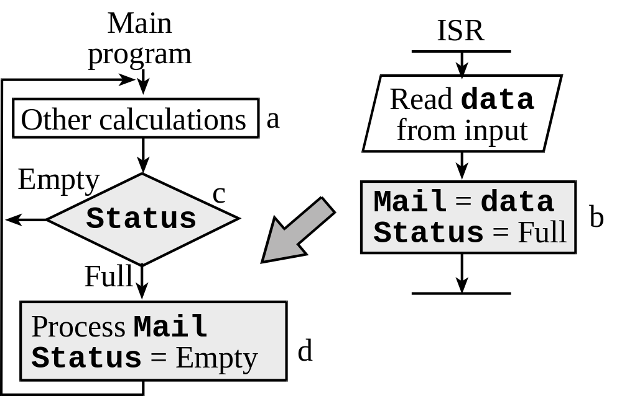
Mailbox
Jonathan Valvano EE445M/EE380L.6

Slide 23
What Does An Operating System Do?
It may not be needed
  “endless loop” frequently sufficient
    loop
      do first task
      …
      do n^{th} task
      loop
  efficient and predictable
    no ‘operating system’ overhead
  but may not be able to handle time constrained asynchronous events
EE 445L – Bard, Valvano

Slide 24
What Does An Operating System Do?
Endless Loop + Interrupts
  permits immediate action for time constrained events
    interrupt activates interrupt service routine (ISR)
    ISR is atomic
    if more than one type of event possible, an event may be missed
  requires programmer to do event scheduling
EE 445L – Bard, Valvano

Slide 25
What Does An Operating System Do?
Multitasking
  processes cooperate to share processor time
    willing to periodically check if other process requires action
  requires careful programming
  ‘buggy’ process can stall system
EE 445L – Bard, Valvano

Slide 26
What Does An Operating System Do?
Preemptive Multitasking
  operating system shifts from process to process
    time slicing
    intervals determined by clock interrupt
  operating system maintains context for each process, e.g., registers, memory allocation
    task control blocks
  processes assigned priority for access to system resources
EE 445L – Bard, Valvano

Slide 27
What Does An Operating System Do?
Scheduling with process priority
  each process has fixed priority
  RTOS scheduler is able to preempt running process if higher priority process activated
    I/O interrupt produces/requires data conversion
  scheduler runs highest priority process
    process typically runs to completion
    may exclude lower priority processes
      exclusion avoidance schemes available
EE 445L – Bard, Valvano

Slide 28
What Does An Operating System Do?
Process attributes
  execution time, process period, and deadline
Execute
Deadline
Start
Process Period
EE 445L – Bard, Valvano

Slide 29
What Does An Operating System Do?
Process priority
  priority is inversely proportional to period
    most frequent tasks have highest priority
  compute sum of compute time/period for every process
    if sum > 1, no schedule possible
  Alternative: highest priority for process with nearest deadline
    less predictable since priority is f(t)
EE 445L – Bard, Valvano

Slide 30
What Does An Operating System Do?
Real Time Operating Systems
  Critical – system fails if time constraints not met
  Dependent – occasional failure to meet time constraint is acceptable
  Flexible – performance degrades as time constraints missed
EE 445L – Bard, Valvano

Slide 31
Processes and operating systems
Multiple tasks and multiple processes.
  Specifications of process timing.
Preemptive real-time operating systems.
adapted from Wolf
EE 445L – Bard, Valvano

Slide 32
Reactive systems
Respond to external events.
  Engine controller.
  Seat belt monitor.
Requires real-time response.
  System architecture.
  Program implementation.
May require a chain reaction among multiple processors.
adapted from Wolf
EE 445L – Bard, Valvano

Slide 33
Tasks and processes
A task is a functional description of a connected set of operations.
(Task can also mean a collection of processes.)
A process is a unique execution of a program.
  Several copies of a program may run simultaneously or at different times.
A process has its own state:
  registers;
  memory.
The operating system manages processes.
adapted from Wolf
EE 445L – Bard, Valvano

Slide 34
Why multiple processes?
Multiple tasks means multiple processes.
Processes help with timing complexity:
  multiple rates
    multimedia
    automotive
  asynchronous input
    user interfaces
    communication systems
adapted from Wolf
EE 445L – Bard, Valvano

Slide 35
Multi-rate systems
Tasks may be synchronous or asynchronous.
Synchronous tasks may recur at different rates.
Processes run at different rates based on computational needs of the tasks.
adapted from Wolf
EE 445L – Bard, Valvano

Slide 36
Real-time systems
Perform a computation to conform to external timing constraints.
Deadline frequency:
  Periodic.
  Aperiodic.
Deadline type:
  Hard: failure to meet deadline causes system failure.
  Soft: failure to meet deadline causes degraded response.
  Firm: late response is useless but some late responses can be tolerated.
adapted from Wolf
EE 445L – Bard, Valvano

Slide 37
Timing specifications on processes
Release time: time at which process becomes ready.
Deadline: time at which process must finish.
adapted from Wolf
EE 445L – Bard, Valvano

Slide 38
Release times and deadlines
aperiodic process
periodic process initiated
by event
deadline
deadline
P1
P1
P1
time
initiating
event
period
period
periodic process initiated
at start of period
adapted from Wolf
EE 445L – Bard, Valvano

Slide 39
Rate requirements on processes
Period: interval between process activations.
Rate: reciprocal of period.
Initiation rate may be higher than period---several copies of process run at once.
CPU 1
P1₁
CPU 2
P1₂
CPU 3
P1₃
CPU 4
P1₄
time
adapted from Wolf
EE 445L – Bard, Valvano

Slide 40
Timing violations
What happens if a process doesn’t finish by its deadline?
  Hard deadline: system fails if missed.
  Soft deadline: user may notice, but system doesn’t necessarily fail.
adapted from Wolf
EE 445L – Bard, Valvano

